Slide 1
Restaurant Reservation Chatbot
Presented By – Udiesh Kumar R
University College of Engineering Villupuram
B.E CSE (3rd Year)
Registration No - 422521104040

Slide 2
Table of contents
01
05
02
06
03
04
Problem statement
The wow in our solution
Project overview
Modelling
Who are the end users
07
Result
Our solution & its proposition

Slide 3
Problem Statement
The restaurant industry faces challenges in efficiently managing reservations. Manual reservation systems can lead to long wait times and errors. Additionally, accessing restaurant information can be cumbersome for customers. There is a need for a solution that streamlines reservation processes and enhances customer communication channels.
The problem is to provide seamless booking and assistance to customers interested in dining at the restaurant.
This can be tackled by incorporating a Restaurant Reservation Chatbot which can respond to customer queries regarding reservation, menu and other amenities provided by the restaurant

Slide 4
Project Overview
The project involves developing a chatbot system using Python and libraries such as NLTK (Natural Language Toolkit) for text processing.
The chatbot is designed to be integrated into the restaurant's website or app, providing a seamless and intuitive interface for customers to interact with.
Technical components include implementing an Artificial neural network(ANN) architecture with Keras for intent classification and response generation, enabling the chatbot to understand natural language queries and provide relevant responses.

Slide 5
Who Are The End Users?
The end users are potential customers looking to dine at the restaurant, seeking assistance in making table reservations, exploring the menu, getting information about the restaurant, and providing feedback.
Additionally, business people who aspire to take their establishments to the next level can benefit from leveraging the chatbot technology. They can utilize the chatbot to enhance customer engagement, streamline operations, and improve overall service quality, thereby maximizing their business potential.

Slide 6
Our Solution & Its Proposition
Our solution involves creating a chatbot tailored for restaurants, focusing on simplicity and effectiveness.
Using Python tools like NLTK, our chatbot can understand and respond to customer messages promptly.
The chatbot automates reservation tasks, generating unique booking IDs and reducing errors, thereby streamlining the booking process and improving operational efficiency.
By learning from interactions, our chatbot continually improves, ensuring it stays helpful and relevant over time.
Overall, our chatbot offers a straightforward and valuable tool for restaurant owners to enhance customer service and streamline operations.

Slide 7
The Wow In Our Solution
Visually Appealing: Our chatbot features a visually appealing interface, enhancing user engagement.
Responsive: It swiftly responds to user queries, ensuring a seamless interaction experience.
High Accuracy: Achieves a high accuracy rate in understanding and responding to user inputs.
Easy to Understand and Use: Designed with simplicity in mind, making it straightforward for users to navigate and utilize effectively.

Slide 8
Modelling
The modelling process involves extracting training data from a JSON file containing intents, patterns, and responses for various user queries.
Data preprocessing techniques, including tokenization and stemming, are applied to prepare the data for training the neural network model.
The model architecture consists of densely connected artificial neural Network layers (ANN) implemented through the Keras Library along with activation functions like ReLU and softmax, enabling accurate intent classification and response generation.
Training the model involves optimizing parameters using techniques such as Adam optimization and monitoring performance metrics like accuracy.
We achieved an overall accuracy of 86% after the training process.

Slide 9
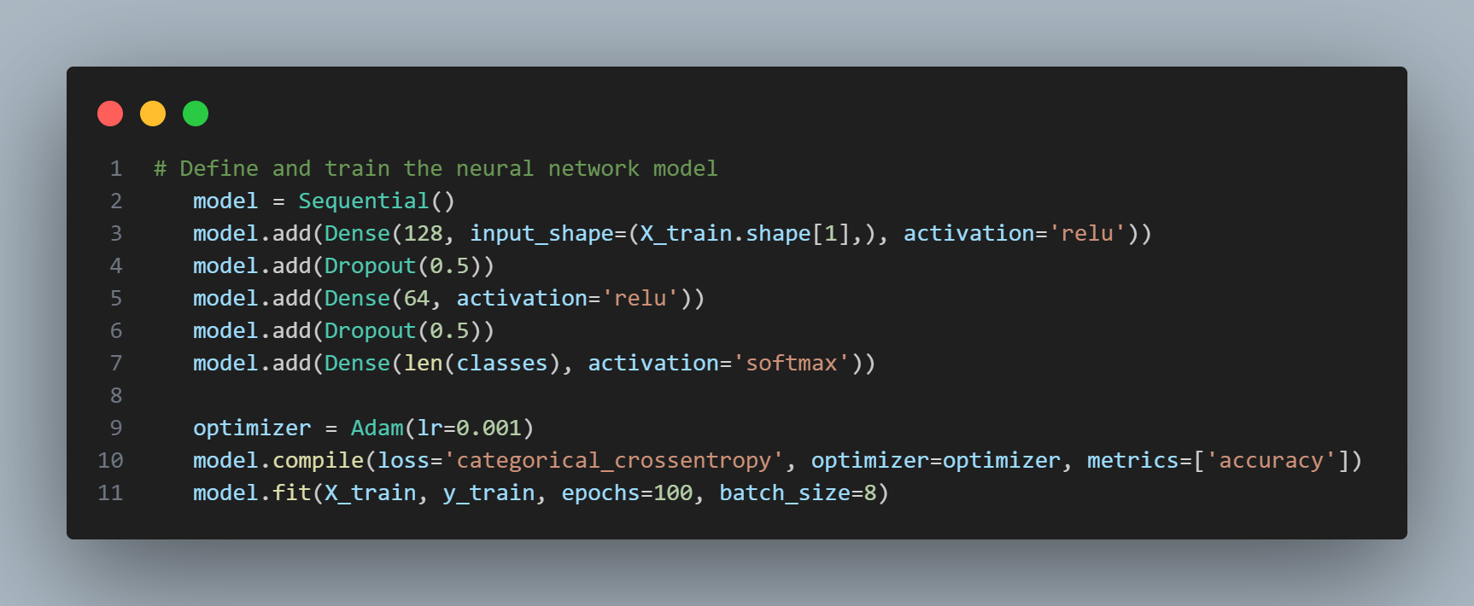
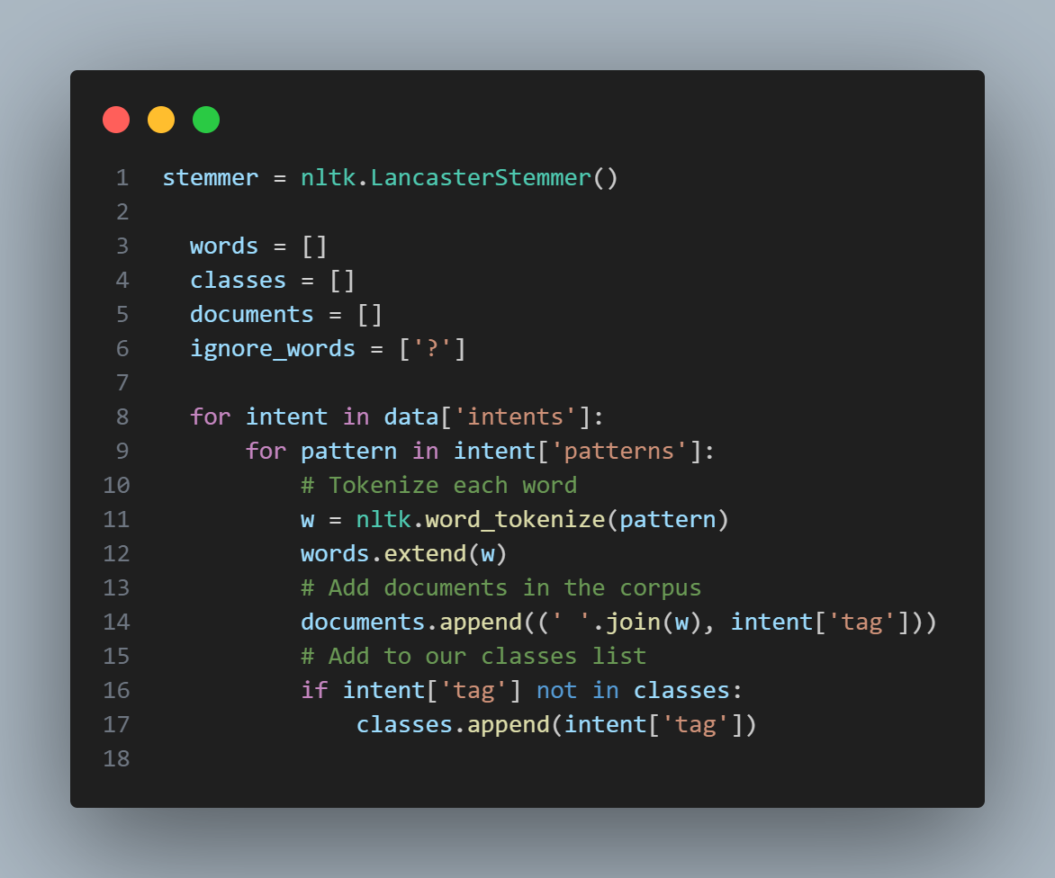
Training the Model
Data Preprocessing

Slide 10
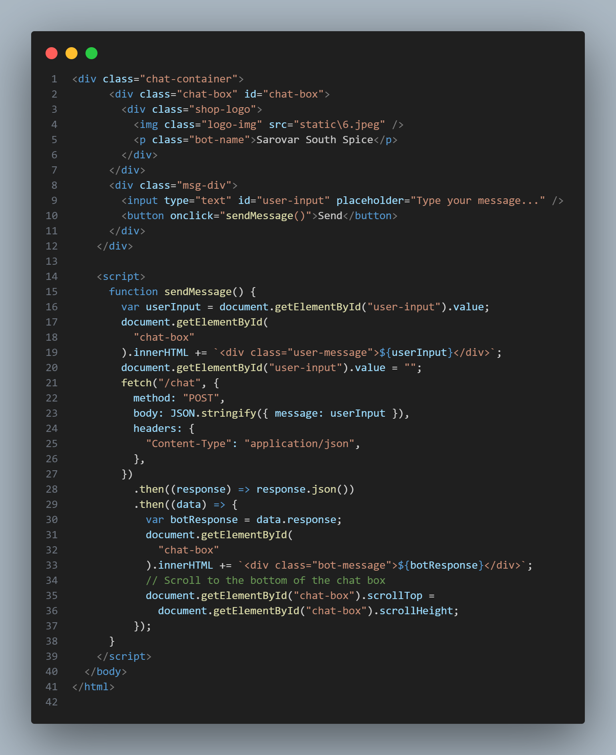
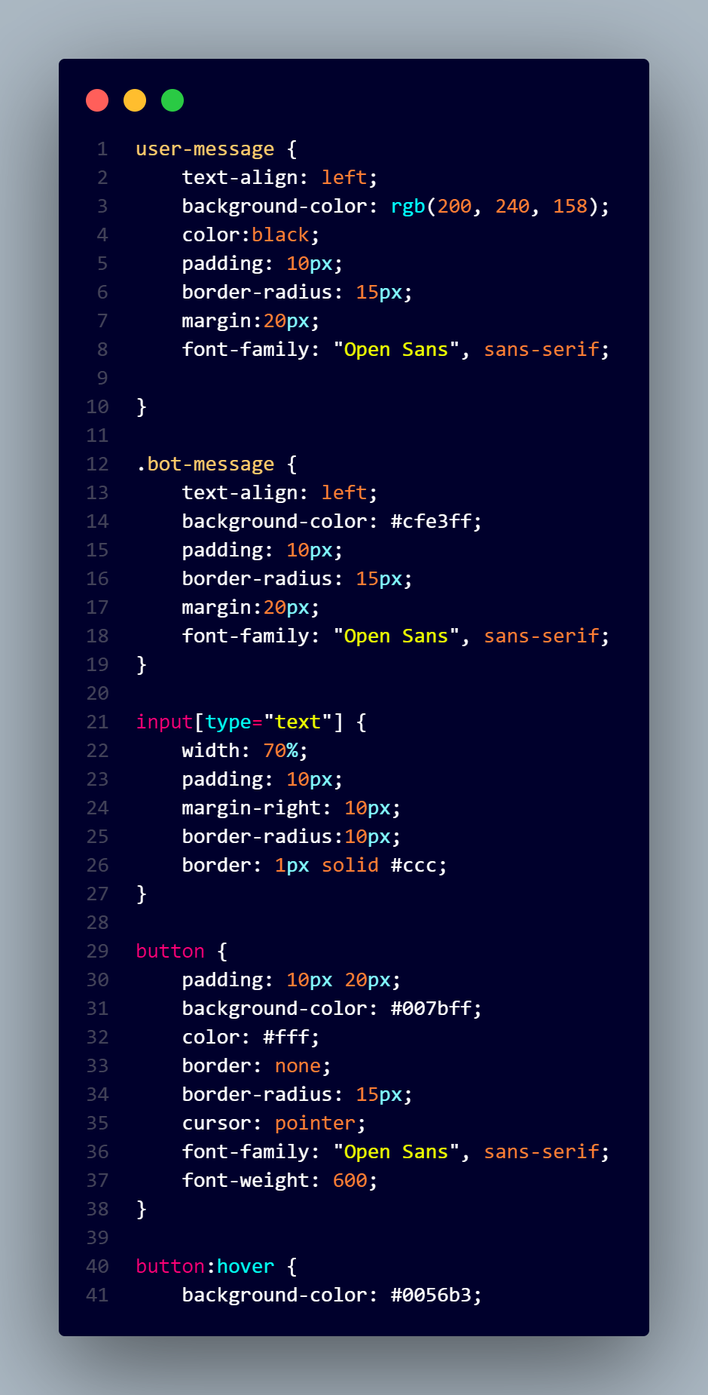
HTML and JavaScript code for chatbot UI Interface
CSS for Styling

Slide 11
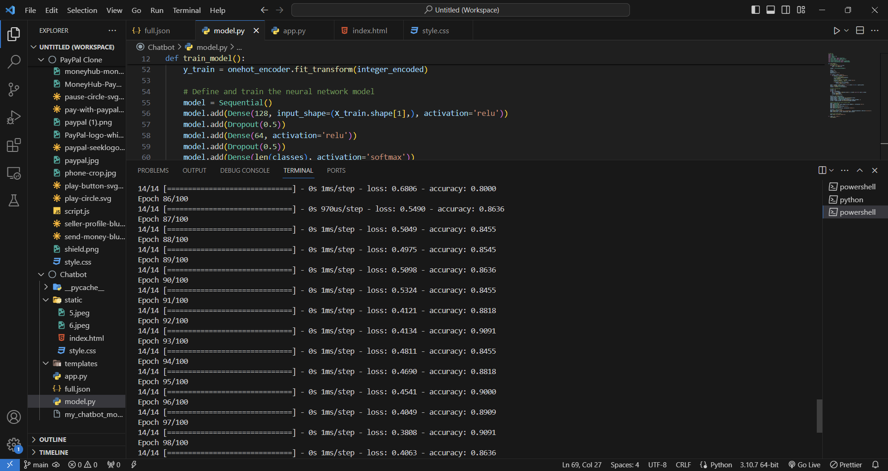
Accuracy Metrics

Slide 12
Result
The chatbot consistently provided accurate responses to different user questions.
Users found it easy to chat with the bot, as it understood and replied well to various queries.
Trained on diverse conversations, the chatbot adapted to different topics and user needs.
Regular checks ensured the chatbot stayed reliable, with few mistakes in responses.
With ongoing learning, the chatbot kept getting better, meeting users' needs effectively.

Slide 13
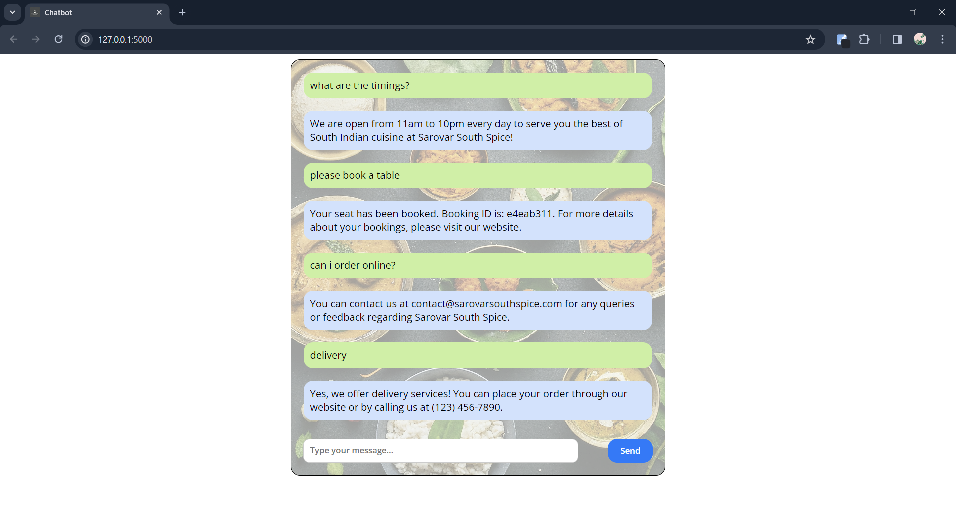
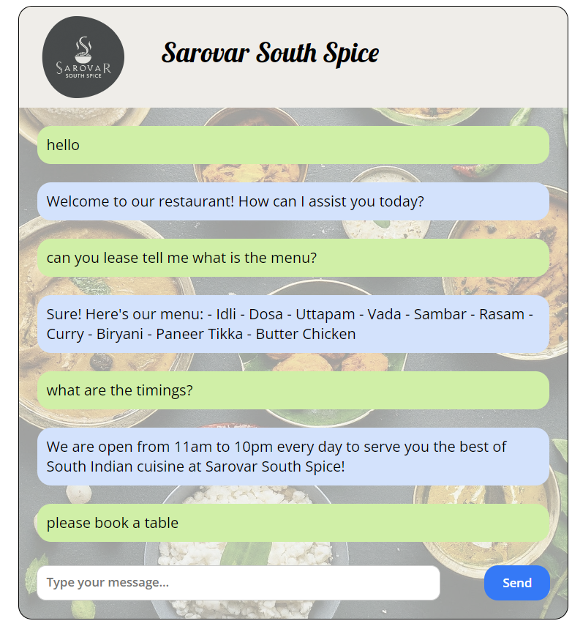
Chatbot In Action

Slide 14
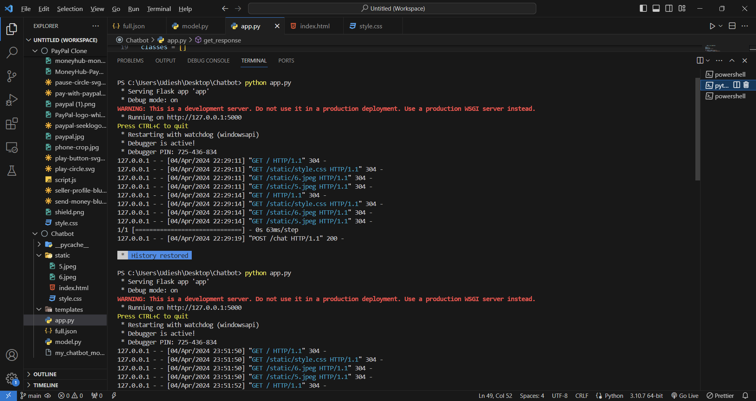
Flask Server Handling the User Query and sending Appropriate Responses Back to the Web Application

Slide 15

Thank You!
Presented By: Udiesh Kumar R
IBM Naan Mudhlavan & EduNet

